Slide 1
Speed up Python
Presentation of results from
“Speed up python.doc”
Mads M. Pedersen

Slide 2
Algorithm
Running time
Worst case: O(…)
x=x*x …
for i in range(n): x*=i
for i in range(n): for j in range(n): x*=i*j
Constant: O(1)
Linear: O(n)
Quadratic: O(n²)

Slide 3
Algorithm
Running time
def pcheck(n): result = True for y in range(2,n): if n%y==0: result = False return result
def pcheck_opt(n): for y in range(2,int(math.sqrt(n))+1): if n%y==0: return False return True
def pcheck_opt2(n): if n==2 or n==3: return True if n%2==0 or n%3==0: return False for y in range(6,int(math.sqrt(n))+2,6): if n%(y-1)==0 or n%(y+1)==0: return False return True
Constant: O(n)
Linear: O(n^{½})
Quadratic: O(1/6*n^{½})
 | pcheck | pcheck_opt | pcheck_opt2
n = 179424691 | 11.410s | 0.001s | 0.001s
n = 179424692 | 11.477s | 0.000s | 0.000s
n = 32416190071 | - | 0.059s | 0.020s

Slide 4
Data structure
def list_structure(lst, primes): result = [] for n in lst: if n in primes: result.append(n) return result | def set_structure(lst, primes): primes = set(primes) result = [] for n in lst: if n in primes: result.append(n) return result
n | N | list_structure | set_structure
1.000.000 | 1000 | 3.462s | 0.073s
1.000.000 | 10000 | 25.203s | 0.079s

Slide 5
Loop structure
def for_loop(f, lst): res = [] for x in lst: res.append(f(x)) return res | def list_comprehension(f, lst): return [f(x) for x in lst] | def map_to_list(f,lst): return map(f,lst)
f | lst | for_loop | list_comprehension | map_to_list
str | range(10**7) | 3.078s | 2.240s | 1.832s
lambda x: str(x).upper() | range(10**7) | 5.605s | 4.337s | 4.278s

Slide 6
String concatenation
def str_for(lst): s = "" for x in lst: s += str(x) return s | def str_join(lst): s_lst = [] for s in lst: s_lst.append(str(s)) return "".join(s_lst) | def str_comp_join(lst): s_lst = [str(s) for s in lst] return "".join(s_lst)
lst | str_for | str_join | str_comp_join
xrange(10**6) | 1.669s | 0.317s | 0.256s

Slide 7
Compiled code
Code | To do at runtime in highlighted line | Time for N=10⁷
for i in xrange(N): C[i] = A[i]+B[i] | Interpret code line Determine types of C[i] and A[i] and B[i] Search for corresponding add method Apply add method Load A[i] and B[i] into registers Add A[i] and B[i] Convert to appropiate data type in order to handle overflow Save C[i] into memory | 1.207 s
for(i = 0;i < N ;i++){ C[i] = A[i]+B[i]; } | Load A[i] and B[i] into register Add A[i] and B[i] Save C[i] into memory | 0.033 s

Slide 8
Numpy
Code (A and B must be numpy arrays) | Time for |A|=|B|=10⁷
C = A + B | 0.030 s
import numpy as np def npcheck(n): y = np.arange(2,int(math.sqrt(n))+1) return np.all(n%y>0)
 | pcheck_opt2 | npcheck
n = 688846502588399 | 2.972s | 0.551s
n = 688846502588398 | 0.000s | 0.531s

Slide 9
Local maximum via Numpy (be creative)
 |  | Example
A | The array | [ 0 2 4 2 0 2 5 5 2 -1]
B=A[1:]-A[:-1] | The gradient | [ 2 2 -2 -2 2 3 0 -3 -3]
C = (B[:-1]>=1) & (B[1:]<=-1) | Local max where negative gradient follows positive gradient | [ F T F F F F F F]
D = np.r_[False, C, False] | Concatenate with False to align with A | [ F F T F F F F F F F]
A[D] | Extract local maximum | [4]

Slide 10
tolist()
def maxima1(A): UP, DOWN = 0,1 delta = UP last_v = A[0] maxima = [] for i in xrange(1,len(A)): if A[i]-A[i-1]>0: delta=UP elif A[i]-A[i-1]<0: if delta==UP: maxima.append(A[i-1]) delta=DOWN return maxima | def maxima2(A): UP, DOWN = 0,1 delta = UP last_v = A[0] maxima = [] for v in A[1:]: if v-last_v>0: delta=UP elif v-last_v<0: if delta==UP: maxima.append(last_v) delta=DOWN last_v = v return maxima | def maxima3(A): UP, DOWN = 0,1 delta = UP last_v = A[0] maxima = [] for v in A[1:].tolist(): if v-last_v>0: delta=UP elif v-last_v<0: if delta==UP: maxima.append(last_v) delta=DOWN last_v = v return maxima
 | maxima1 | maxima2 | maxima3
|A| = 1000000 | 1.787s | 1.393s | 0.210s

Slide 11
Cython
ipython notebook

Slide 12
Parallelization
Process A
Read x
Add 1
Write x
Process A
Read x
Add 1
Write x
X
0
0
1
1
Race conditions
Deadlocks /starvation
Synchronization overhead
GIL: Global Interpreter Lock
Python threads: Concurrently but not parallel

Slide 13
Parallelization
Execution time, sec | Sequential | CPython threads | multiprocessing | Parallel Python, PP
 | def task(): n = xrange(5000000) for i in n sum = (i*i) def task_x2(): task() task() | from threading import Thread class TaskThread(Thread): def run(self): task() def taskThread_x_2 (): t1 = taskThread() t2 = taskThread() t1.start(); t2.start() t1.join(); t2.join() | from multiprocessing import Process def multi_processing(): p1 = Process(target=task) p2 = Process(target=task) p1.start(); p2.start() p1.join(); p2.join() | import pp s = pp.Server() def taskPP_P(): t1=s.submit(task) t2=s.submit(task) t1() t2()
Python 2.7 | 5.84s | 8.94s | 3.46s | 3.12s
Python 3.2 | 3.90s | 3.89s | 2.34s | Not supported

Slide 14
GPU (just because it’s cool)
import numpy import pycuda.autoinit import pycuda.driver as drv from pycuda.compiler import SourceModule mod = SourceModule(""" __global__ void multiply_them(float *c, float *a, float *b) { const int i = threadIdx.x; c[i] = a[i] * b[i]; } """) multiply_them = mod.get_function("multiply_them") a = numpy.random.randn(1024).astype(numpy.float32) b = numpy.random.randn(1024).astype(numpy.float32) c = numpy.zeros_like(a) multiply_them(drv.Out(c), drv.In(a), drv.In(b), block=(1024,1,1)) assert numpy.array_equal(c,(a*b))

Slide 15
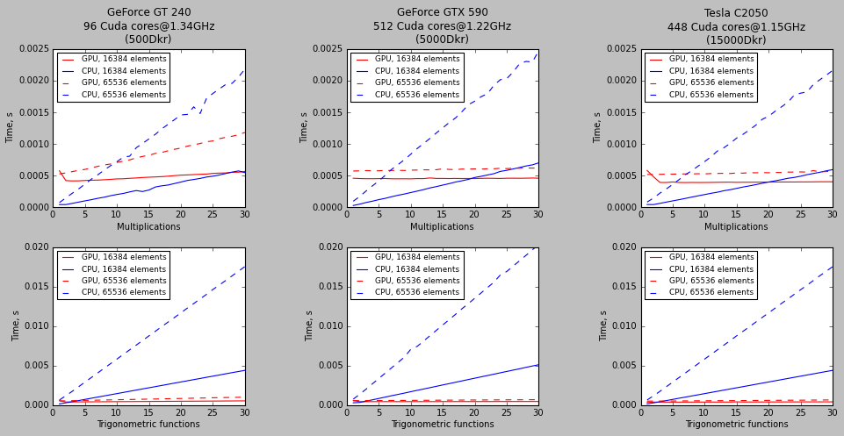
GPU

